Slide 1
CSC3122 – Mobile Computer Systems Development Personas and User Stories

Slide 2
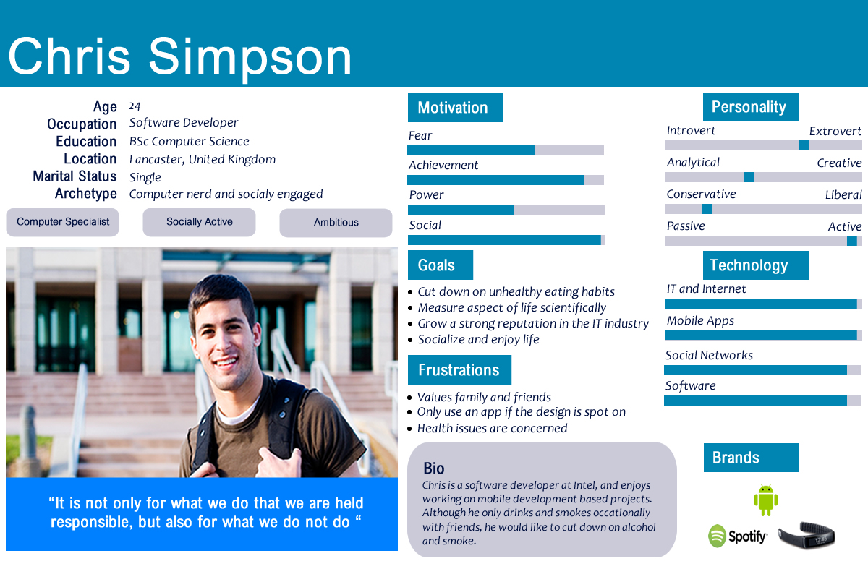

Slide 3
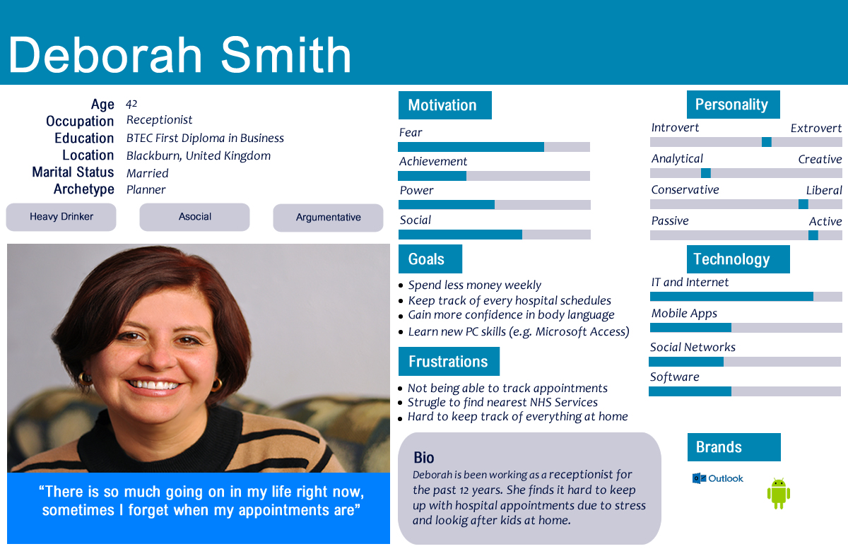

Slide 4
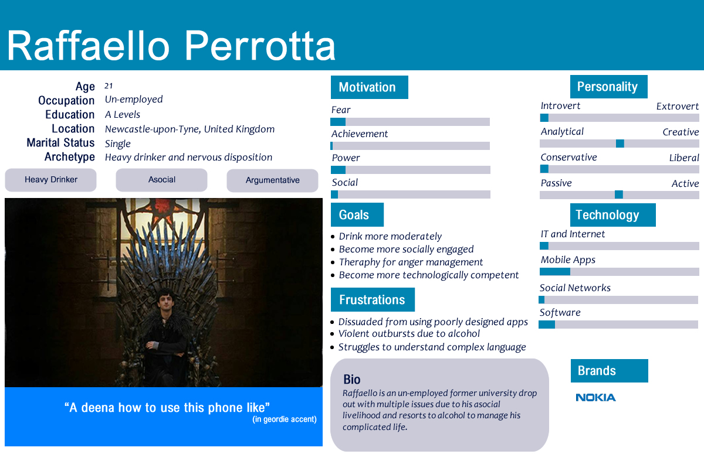

Slide 5
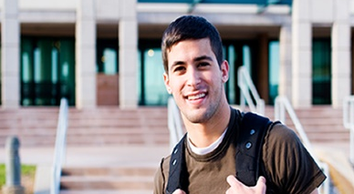
User Stories
Chris Simpson
As a Software Developer, design is something very important to me when it comes to using an app
Instead of having to contact someone, I would like to find the nearest NHS services nearer to me
I want to be able to keep a track of all my hospital appointments
Within a busy environment it is hard to find the information on the internet, so I want to quickly find what I am looking for

Slide 6
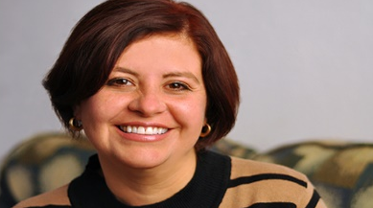
User Stories
Deborah Smith
As a Receptionist, I would like to find services that provides by NHS easily without any hassle
I would like set out reminders within the app to pickup prescription or regular check-up sessions with GP
I need an app that is not complicated to use and easily find what I am after
App should be able to show me all my booked appointments without having to call someone else to find out

Slide 7
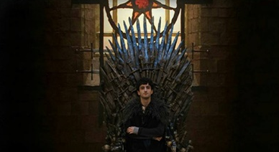
User Stories
Raffaello Perrotta
App should be relatively easy to use without having to figure out how to use it
Design is very important to me and I wouldn’t use an app that is not been designed very well
App should be able to give further information and it should be easy to manage
I would like to see all my appointments with a click of a button

